Slide 1


PREDICTING OBESITY LEVELS USING MACHINE LEARNING AND DEEP LEARNING METHODS
Infosys Internship 5.0
MENTOR: NARENDRA KUMAR

Slide 2
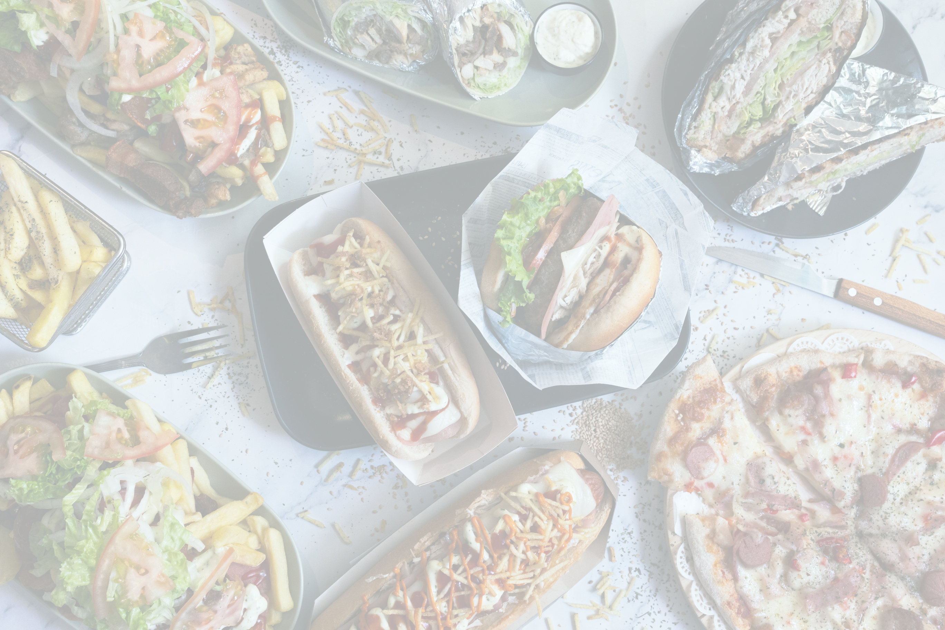
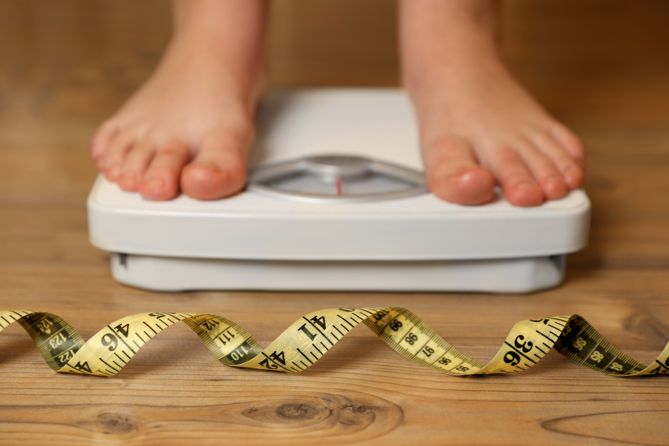
INTRODUCTION
Goal:
To develop predictive models assessing obesity levels based on lifestyle and physical conditions.
Dataset:
Sourced from Kaggle: "Obesity based on eating habits and physical conditions."
50,000 entries, 16 features (e.g., Age, Gender, BMI, Physical Activity).
Outcomes:
Classify individuals into Underweight, Normal weight, Overweight, or Obese.
Promote healthier lifestyle decisions.

Slide 3
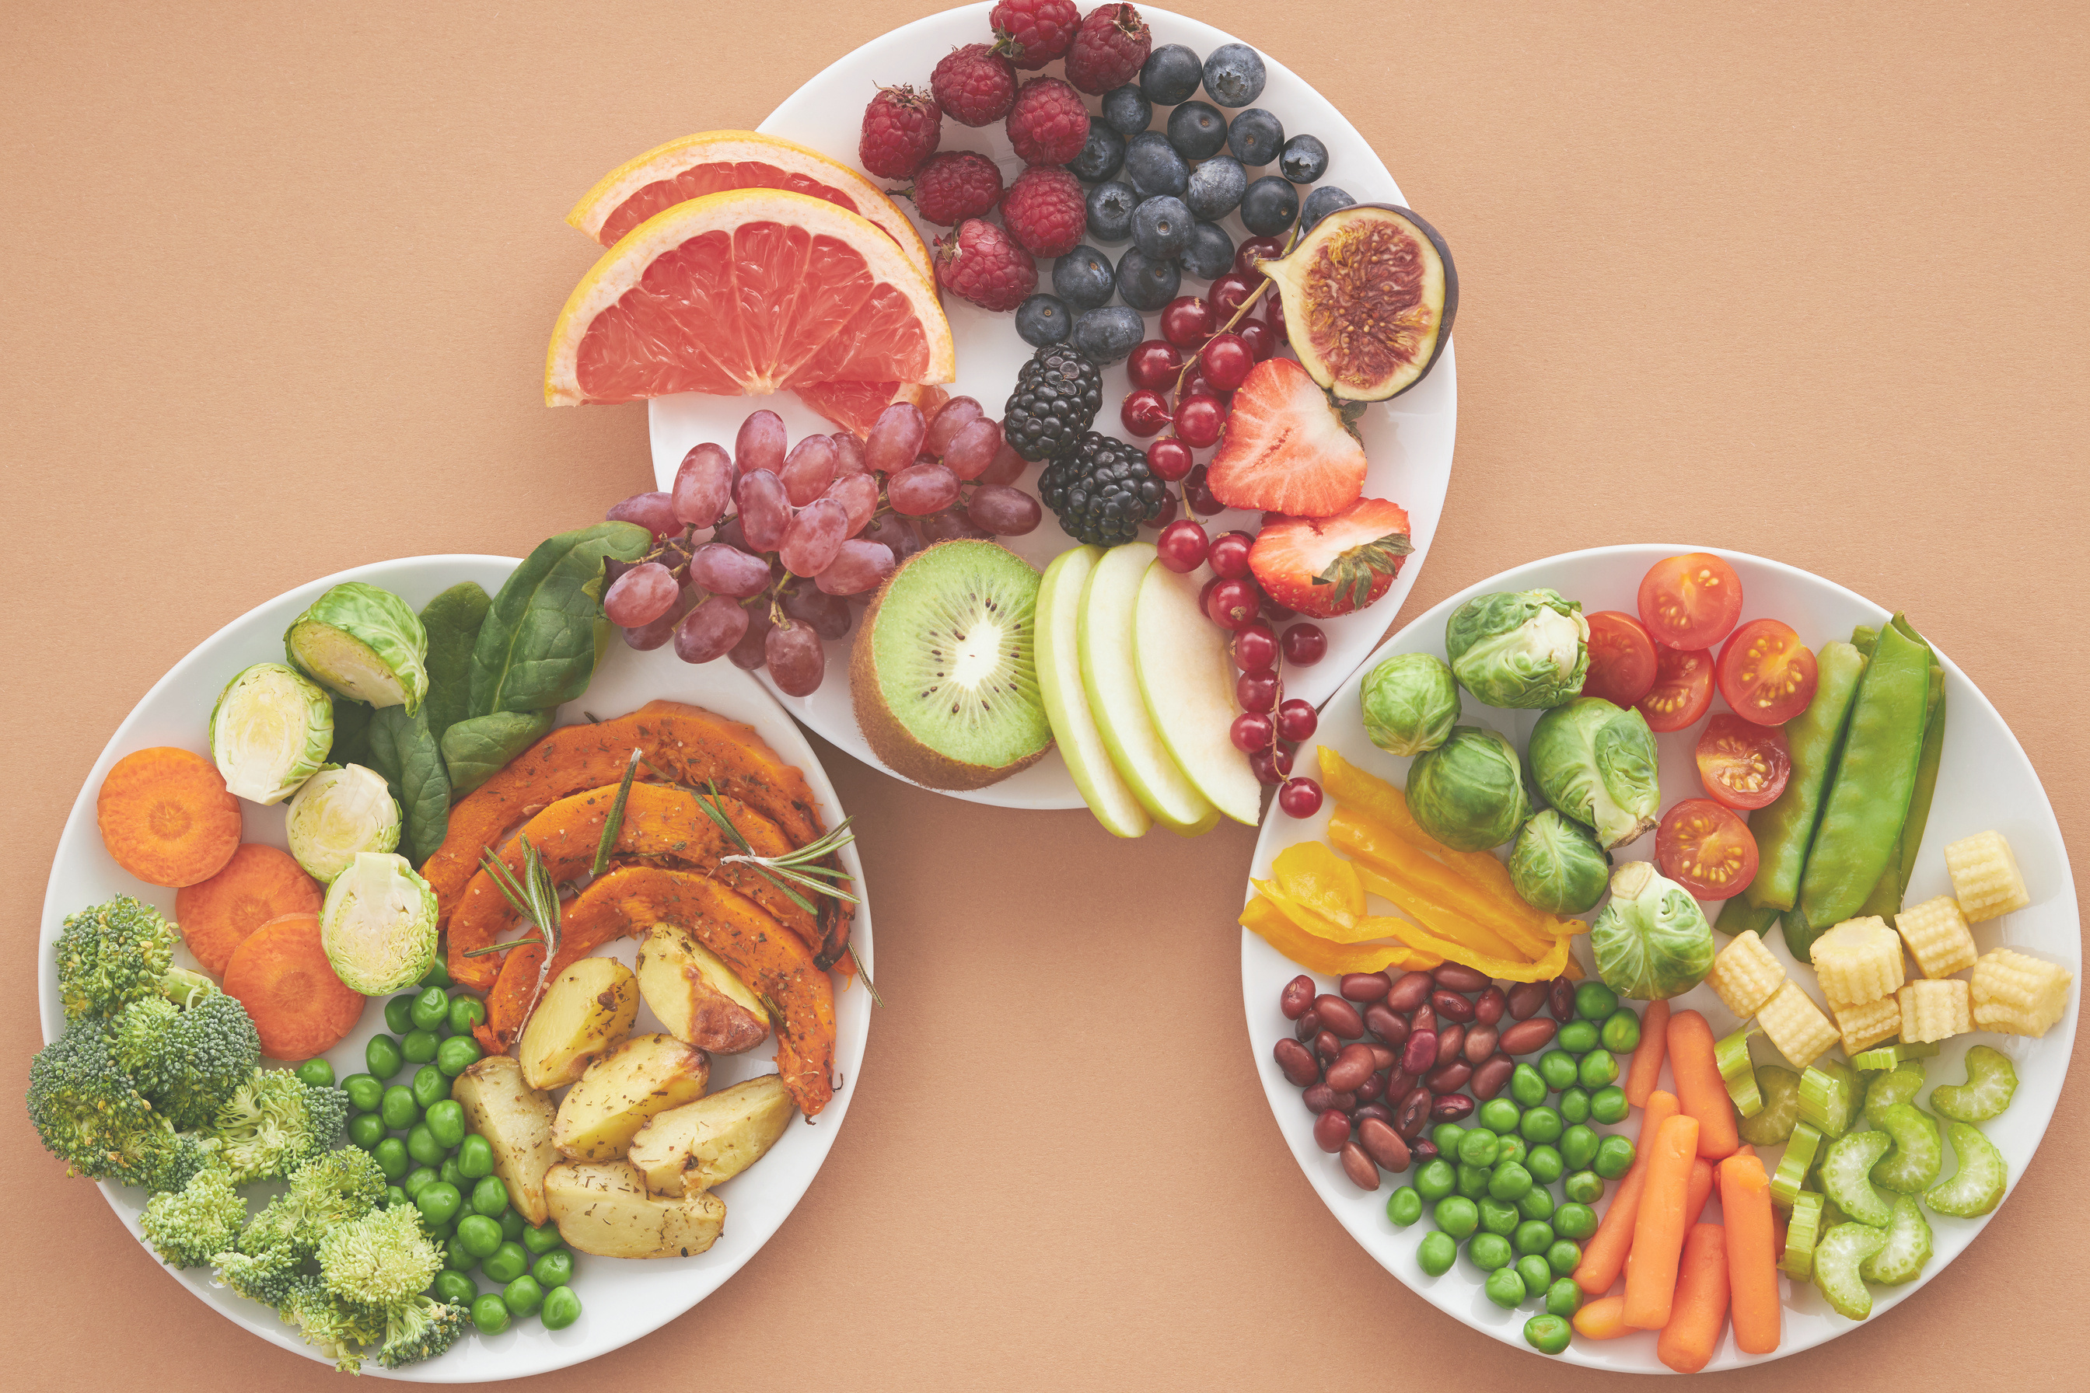

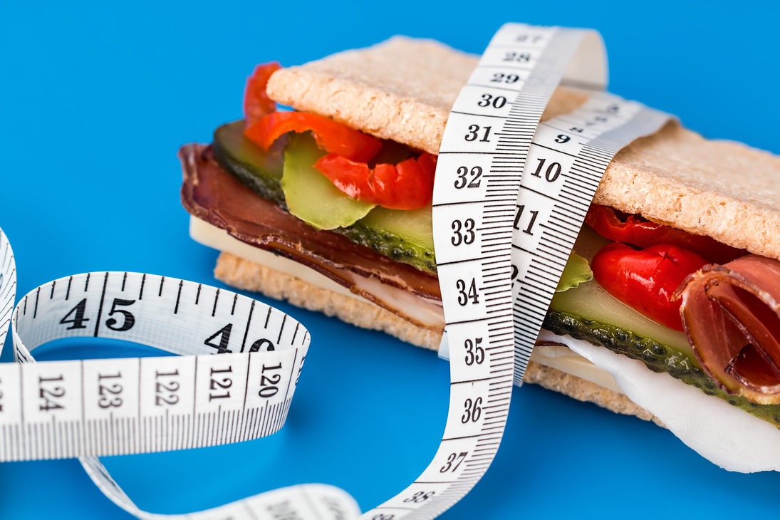
PROBLEM STATEMENT
Obesity rates rising globally, increasing risks of cardiovascular diseases and diabetes.
SOLUTION
AI-driven system for personalized obesity risk prediction and recommendations.
Need for precise identification of obesity levels for targeted interventions.

Slide 4

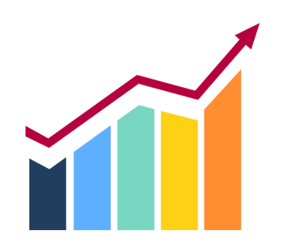

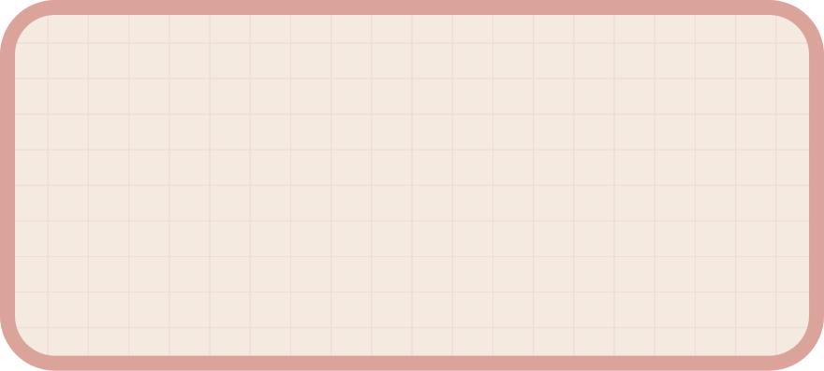
IMPLEMENTATION
Data Exploration (EDA) & Data Preprocessing
Build Machine Learning & Deep Learning Models
Hyperparameter Tuning
Data Collection
Deployment
Web -Based
Solution
Model
Evaluation

Slide 5

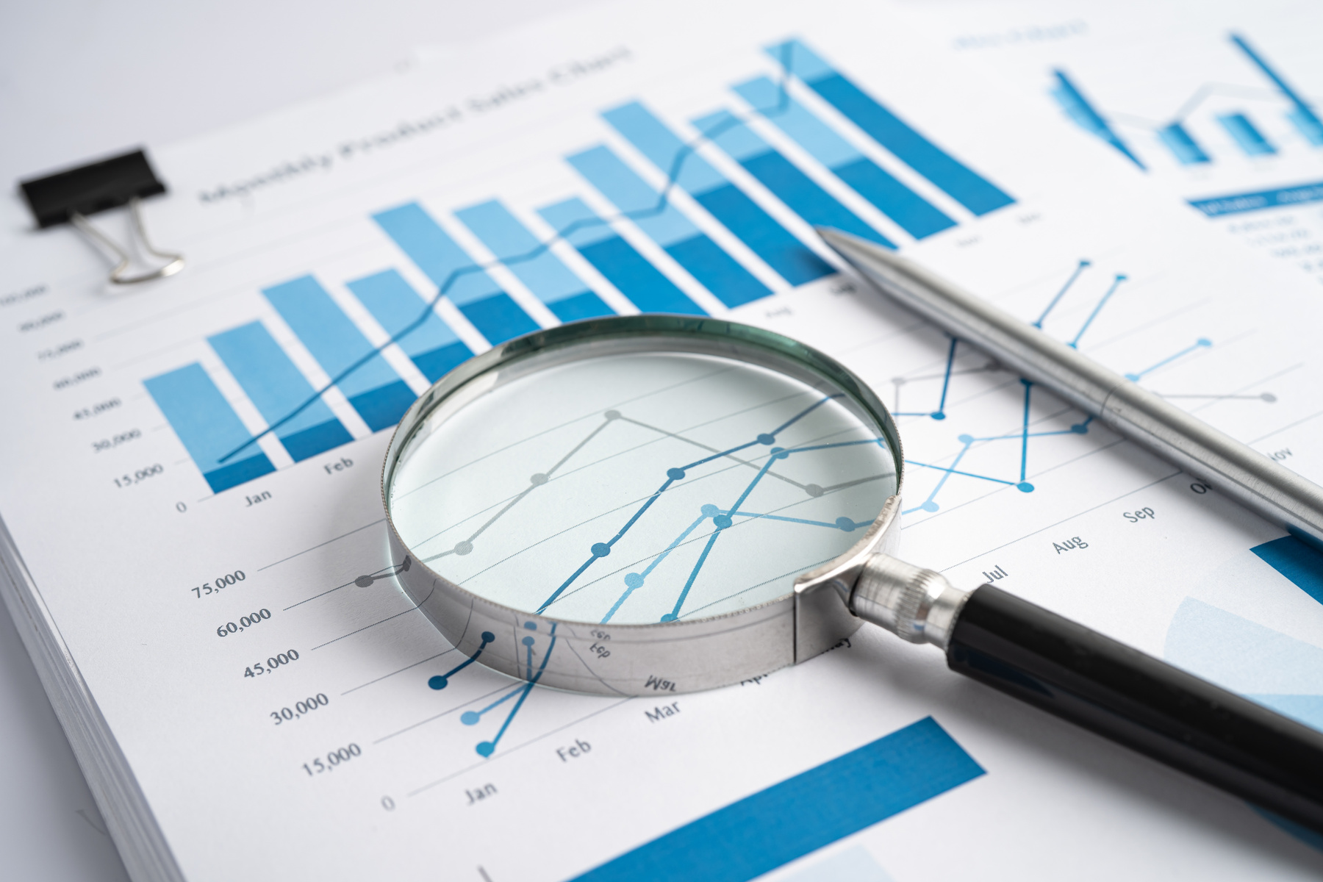
DATA PREPROCESSING
TARGET COLUMN CREATION:
ENCODING CATEGORICAL VARIABLES:
Derived Obesity_Status from BMI values.
Categories: Underweight (<18.5), Normal (18.5–24.9), Overweight (25–29.9), Obese (≥30).
Used Label Encoding for features like Gender and Race.
FEATURE SCALING:
DATA SPLITS:
Applied StandardScaler to normalize data.
Training: 70%, Validation: 15%, Testing: 15%.

Slide 6
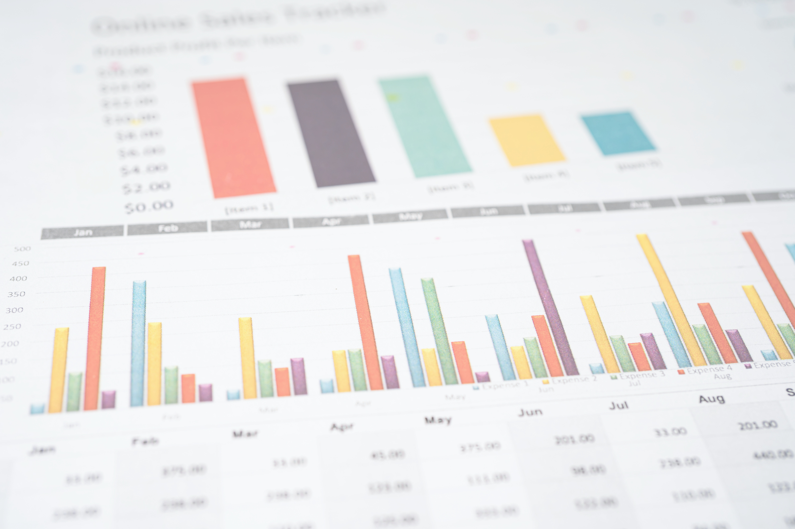
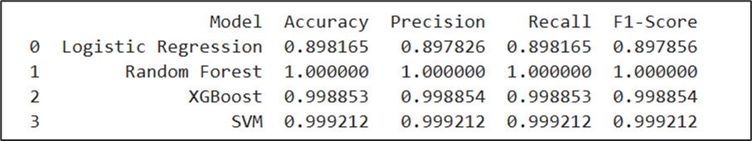
MACHINE LEARNING MODELS
Algorithms Used:
Logistic Regression: Baseline model.
Random Forest: Ensemble model for reduced overfitting.
XGBoost: Gradient boosting for high accuracy.
SVM: Effective in high-dimensional spaces.
Key Metrics: Accuracy, Precision, Recall, F1-score.

Slide 7
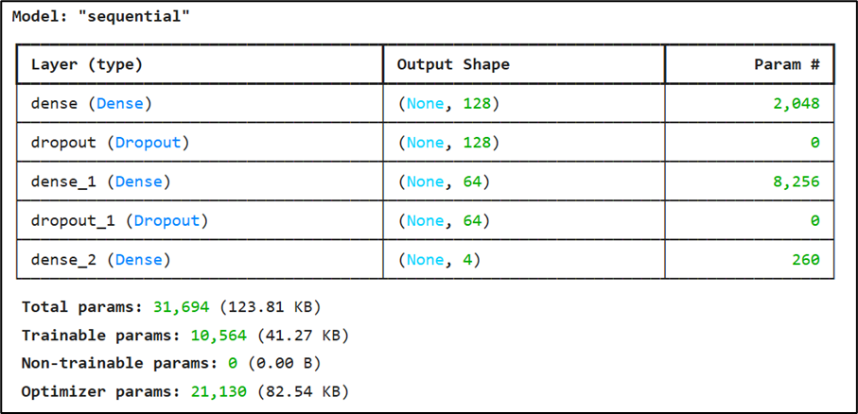
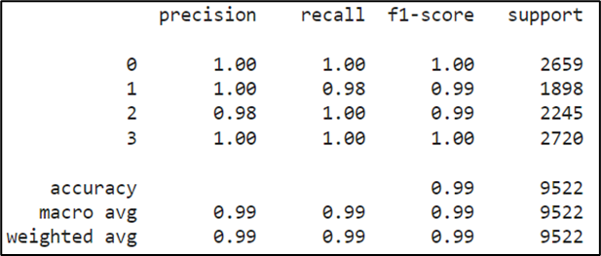
DEEP LEARNING MODELS
Models Implemented:
Sequential Model:
Linear stack of Dense and Dropout layers.
Achieved accuracy: 99.2%.
TabNet:
Attention-based for feature selection.
Achieved accuracy: 99.3%.
Optimization Techniques:
Focal Loss for imbalanced datasets.
Early stopping for efficient training.

Slide 8
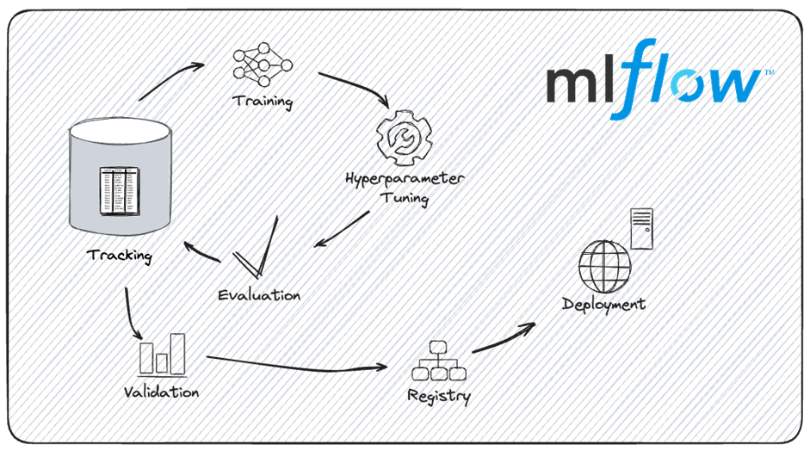
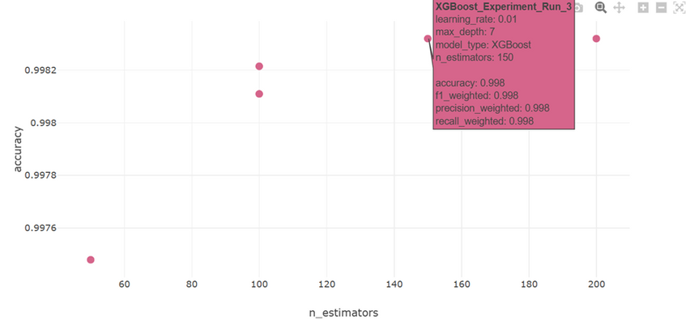
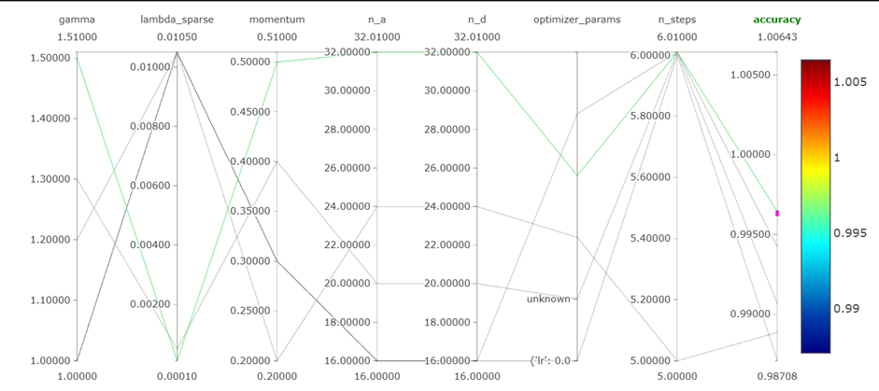
MLFLOW INTEGRATION
Manage machine learning workflows.
Experiment tracking for parameters, metrics, and artifacts.
Reproducibility through organized experiment logs.
Model versioning for streamlined deployment.
Few results are shown below:
XGBoost
TabNet

Slide 9

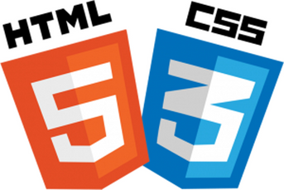
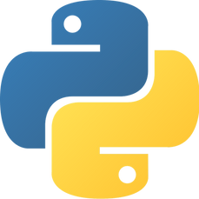
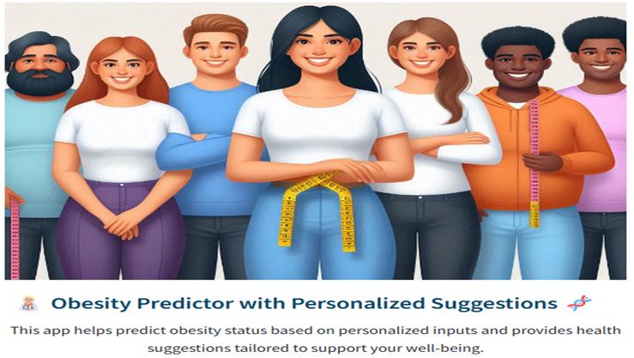
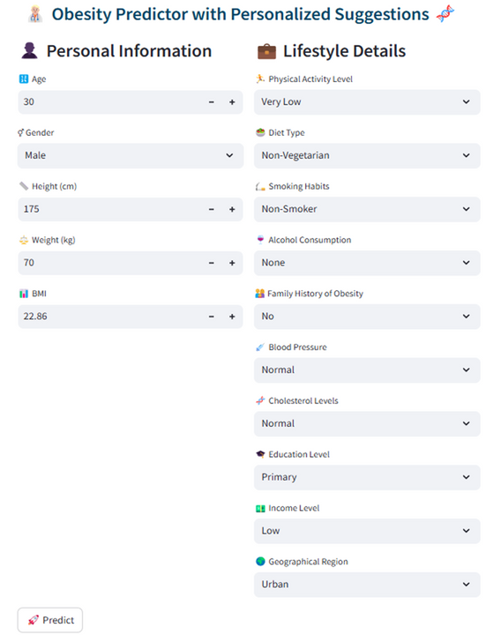
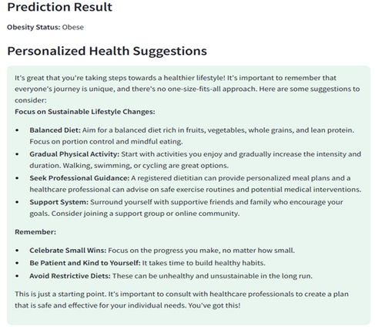
WEB-BASED SOLUTION
Interface Features:
User Input Form: Fields for age, weight, height, lifestyle, and health data.
Prediction Output: Obesity status and personalized health suggestions.
Technologies Used: Streamlit, HTML, CSS, Flask.
Goal:
Democratize access to obesity risk assessments.

Slide 10

RESULTS & KEY FINDINGS
Best Performers:
ML: XGBoost (99% accuracy).
DL: TabNet (99% accuracy).
Insights:
Deep learning captured more complex patterns than ML models.
Feature importance analysis provided actionable health insights.
LINK to the DEMO Video:
https://1drv.ms/v/c/72cb816e1cc47216/EfjW3gEkbRpNqZv4VHjv_O0Bn2aURPmgFzoMG4YafyutmA?e=TtjxhD

Slide 11
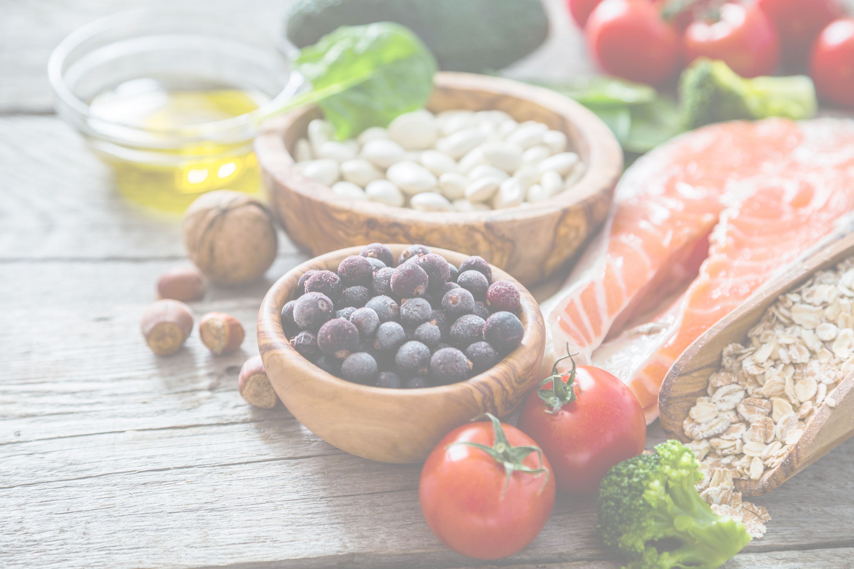
THANK YOU

